Slide 1
HLI Training
Hair Loss Innovations & Training | HAIR LOSS TREATMENT | Manchester, UK (hairloss-innovations.co.uk)

Slide 2
HLI This is a demonstration on a single hair extension micro ring & stick tip application.

Slide 3
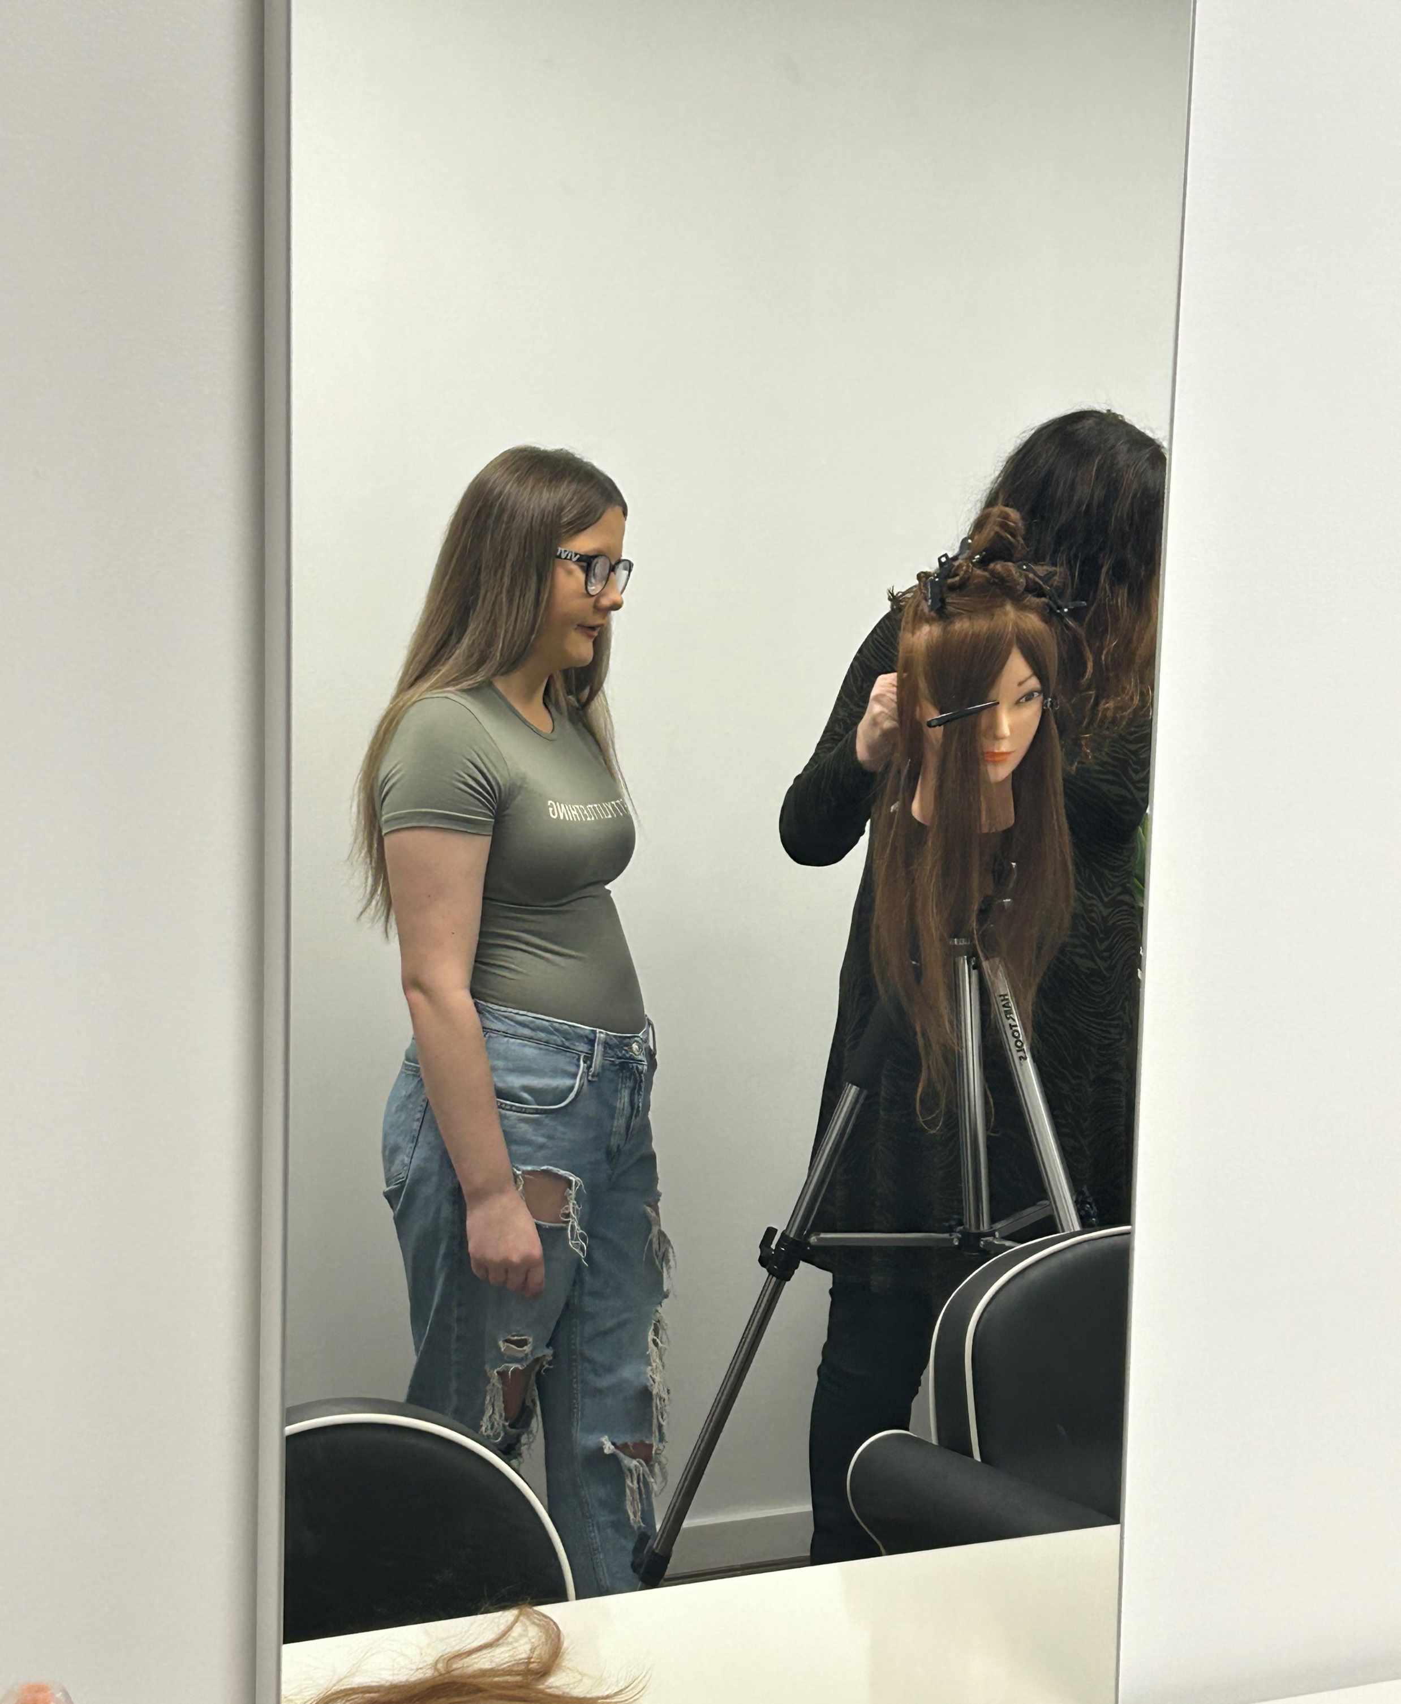
HLI Learner observing demonstration of micro ring & stick tip application.

Slide 4
HLI Learner attempting application with single hair extension stick tip, Looper & micro ring.

Slide 5
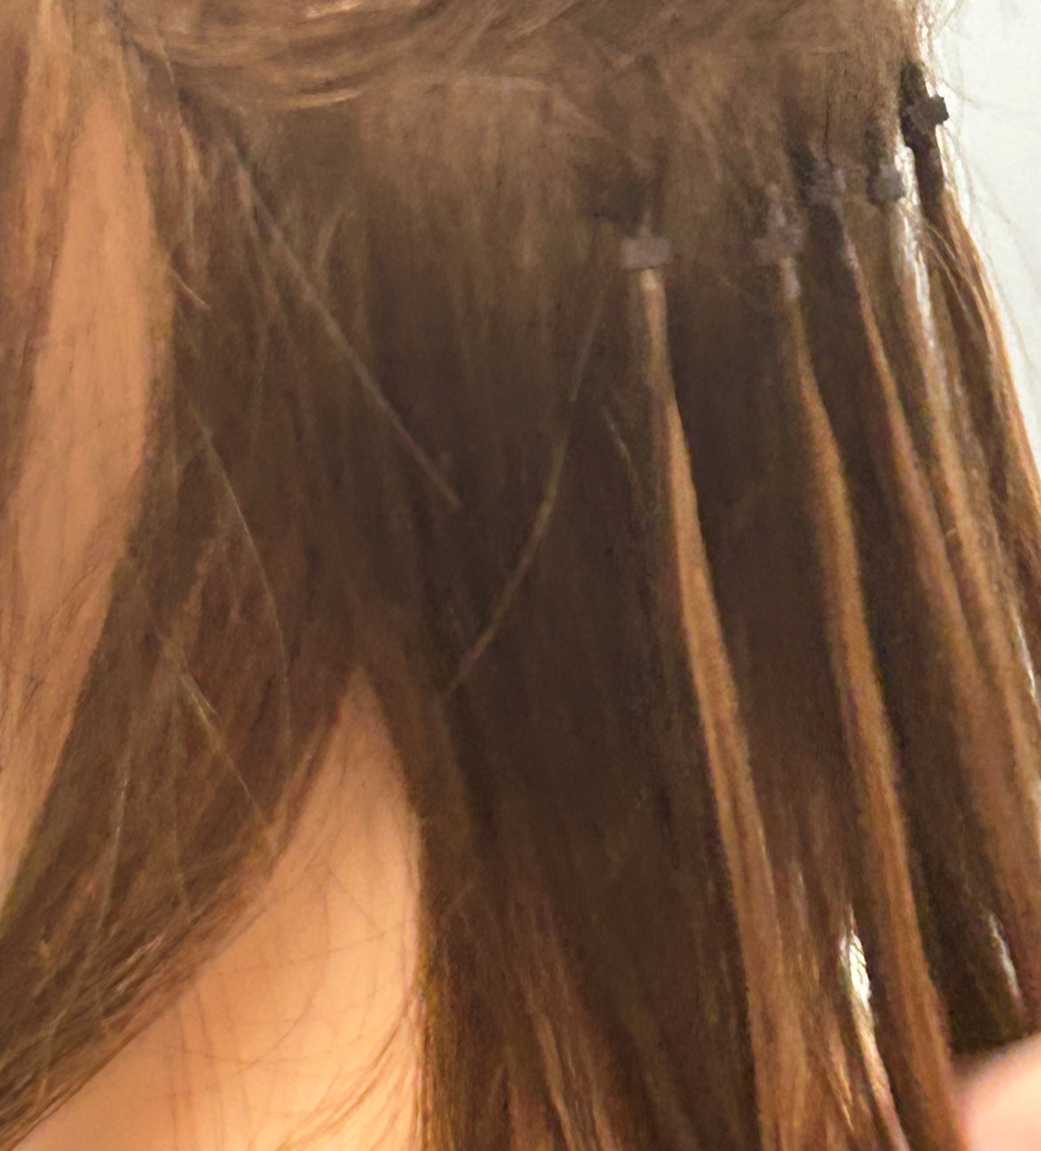
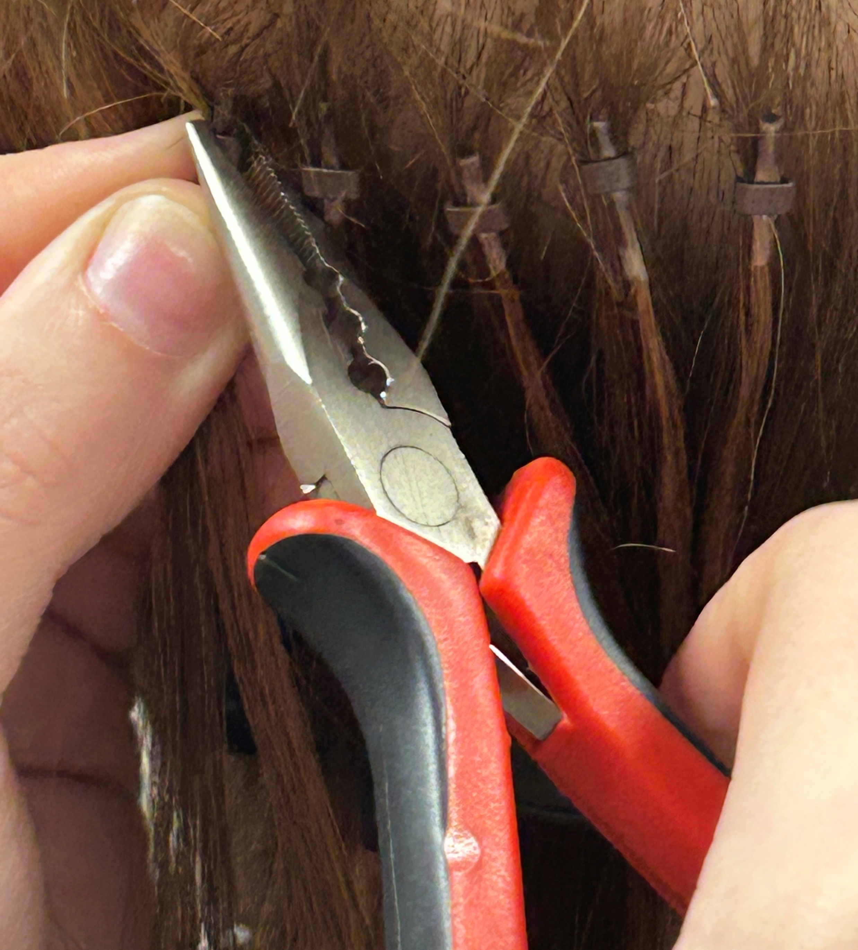
HLI Completion of single hair extension stick tip row.
Completed Row

Slide 6
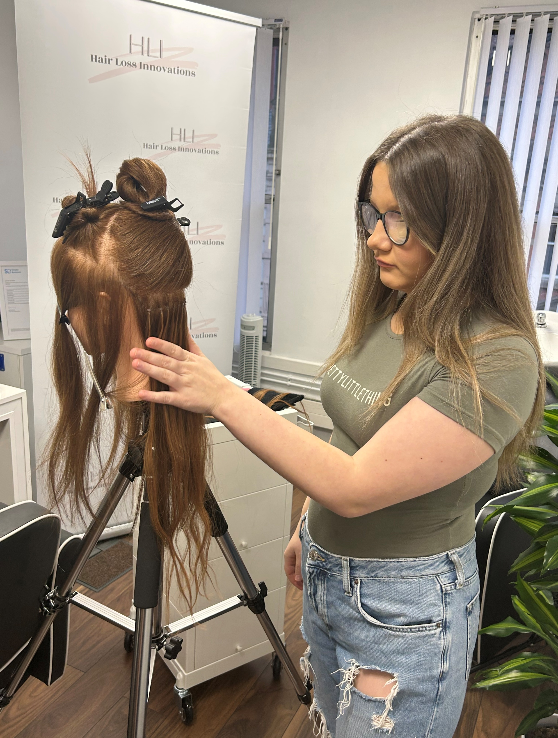
HLI Learner happy with completed row. Ready to complete next technique

Slide 7
HLI Hair Loss Innovations & Training | HAIR LOSS TREATMENT | Manchester, UK (hairloss-innovations.co.uk)

