Slide 1
Crown Volumiser
Client overview

Slide 2
Client with Alopecia
Thinning hair line.
Alopecia patches on crown area.

Slide 3
Stage One: Consultation
After an in-depth consultation with my client, a Crown Volumiser application was agreed. This method will conceal patches of Alopecia and give volume to thinning areas at the front area. My client wanted a natural look, mirroring her own hair.
At this stage, a colour match was identified and agreed.
The next stage would be the time and date of fitting.

Slide 4
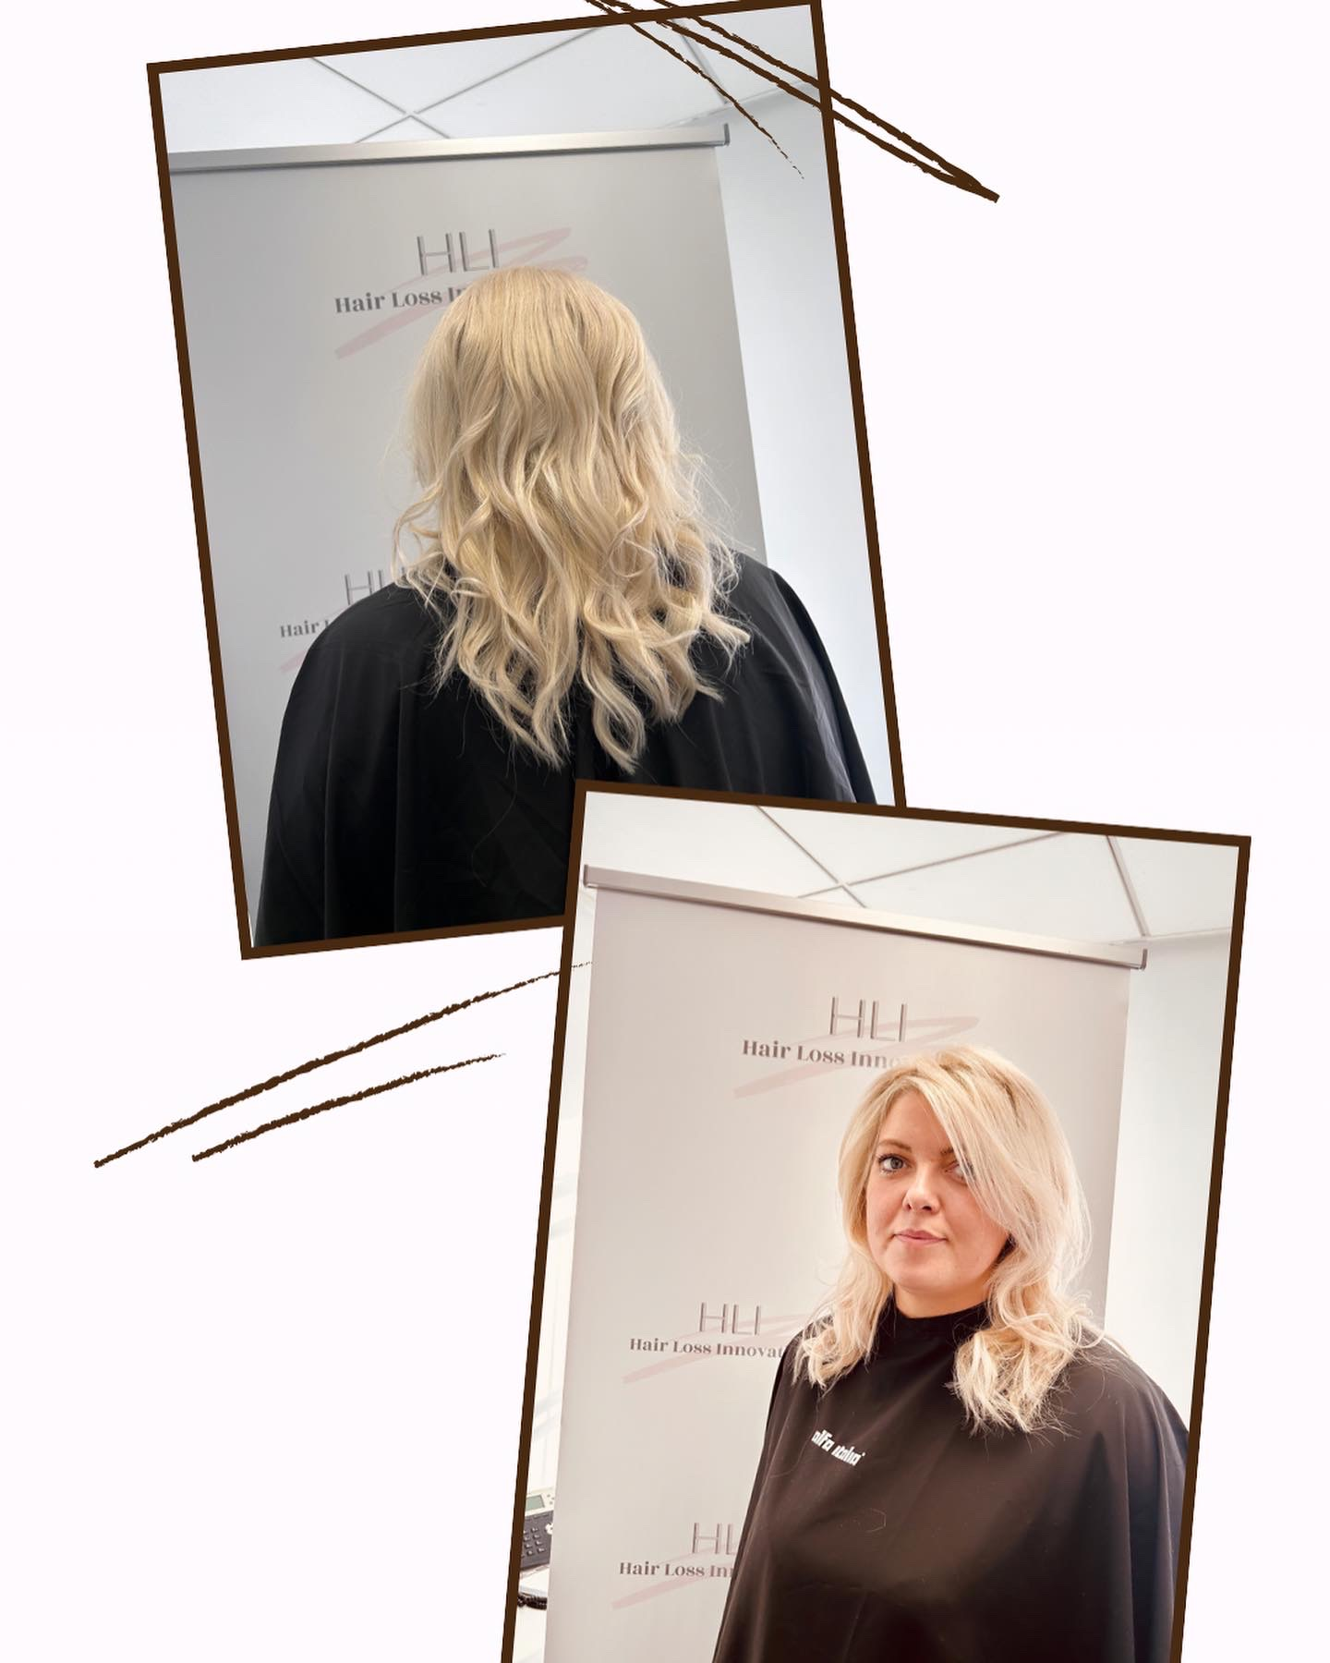
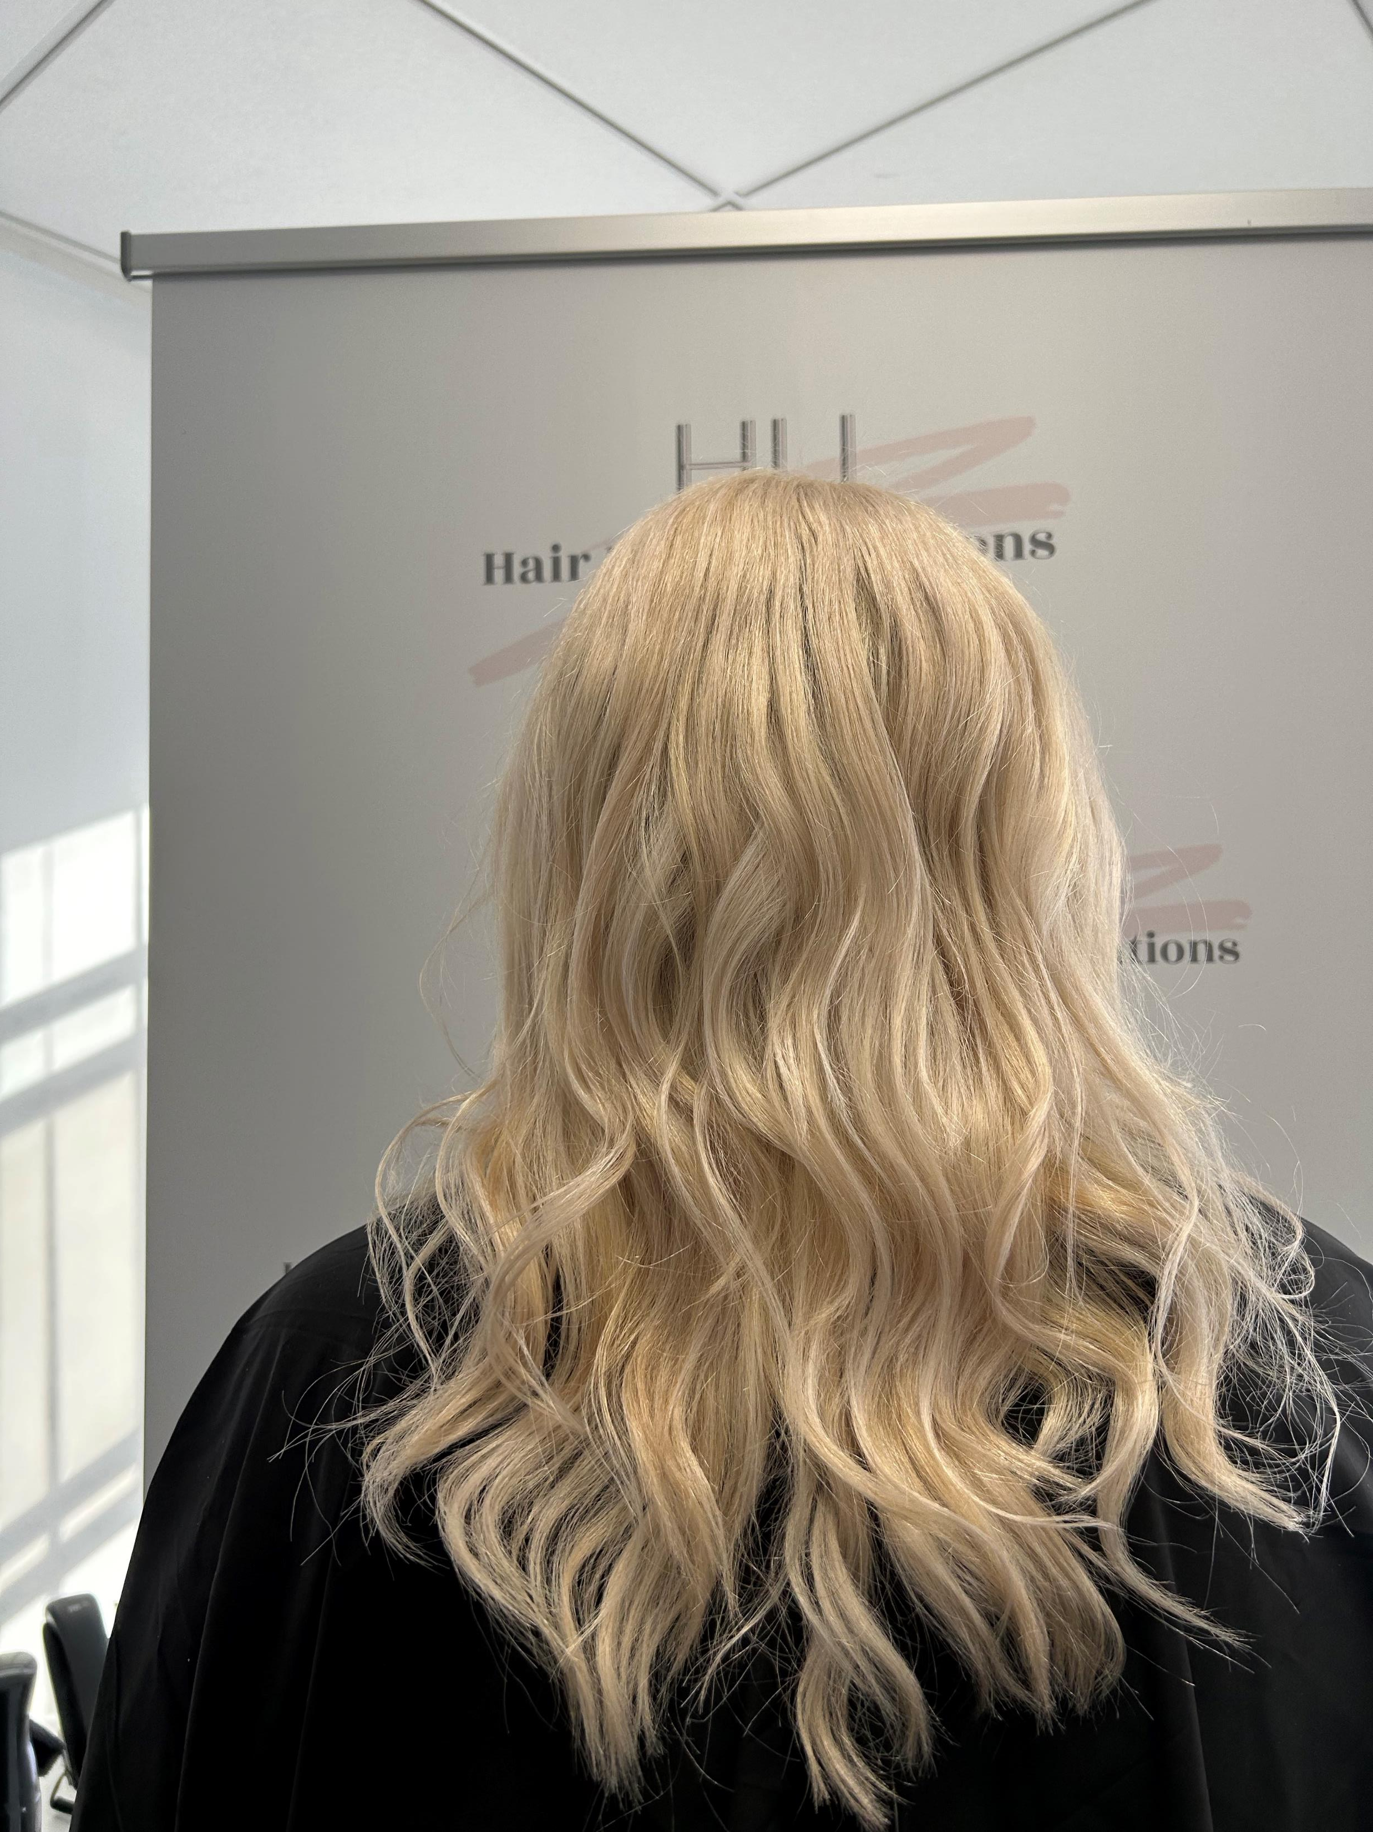
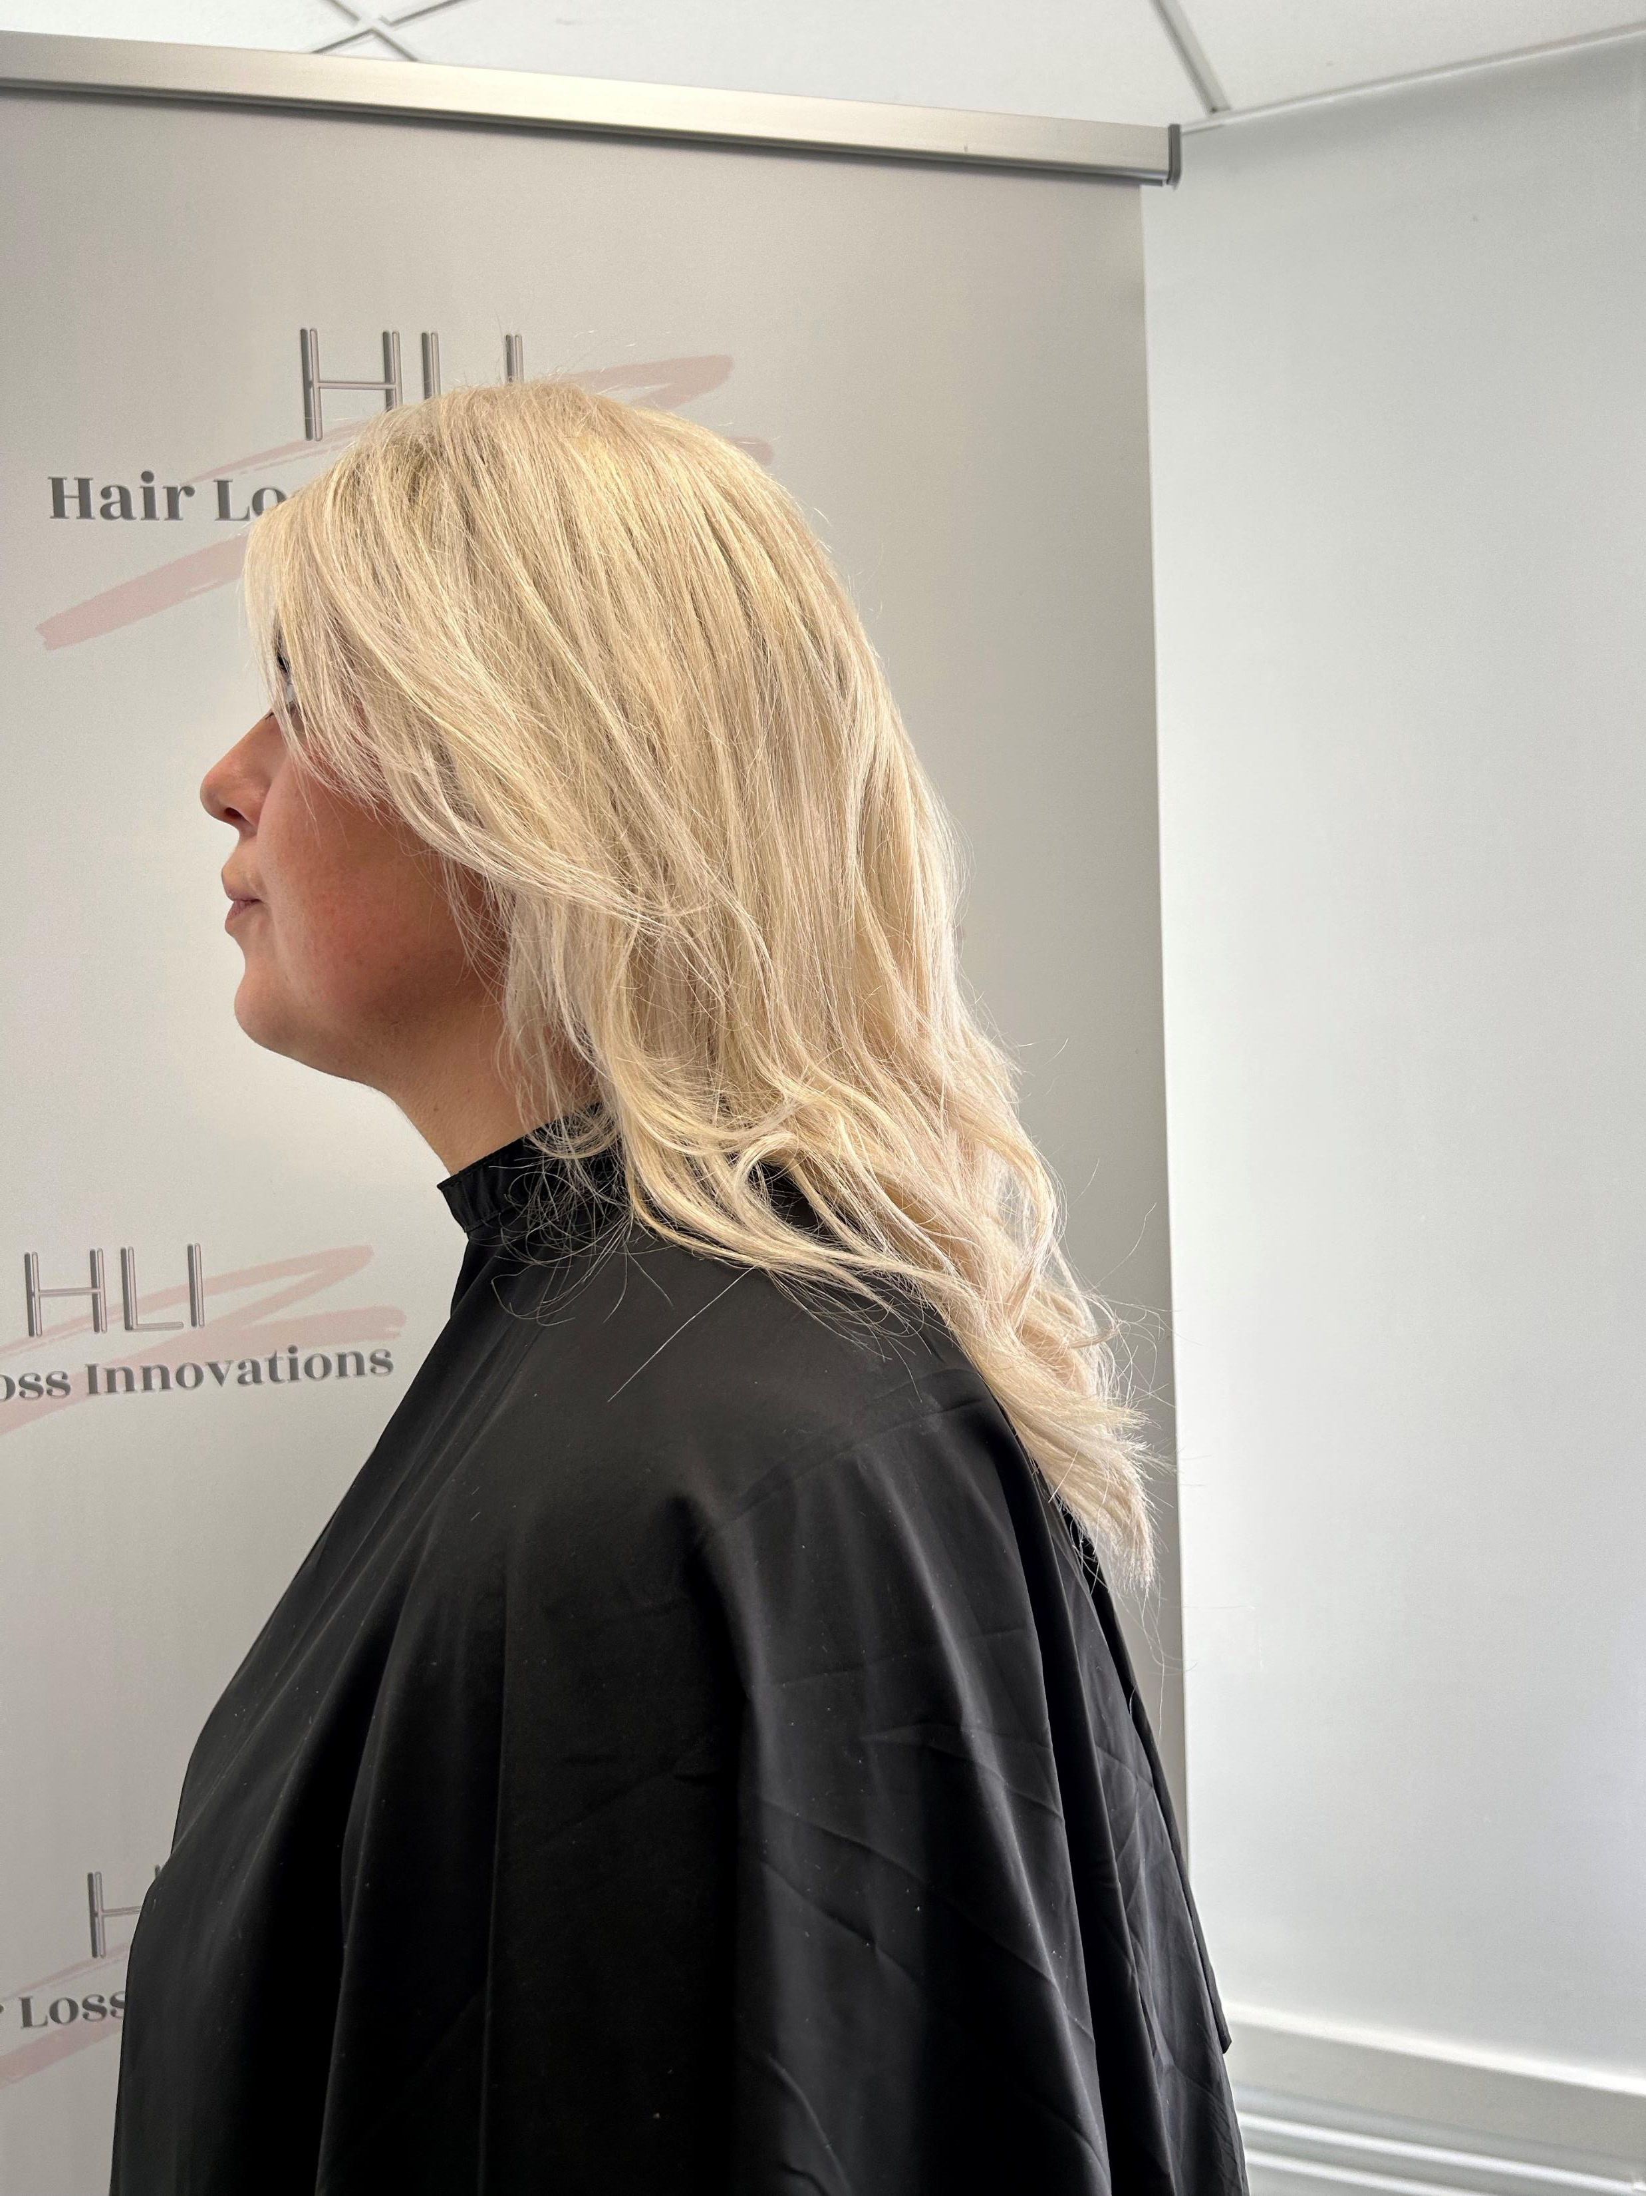
Stage Two: Completed Crown Volumiser Application
Client very happy with result.

